Slide 1
Lecture 5: Clean Energy

Slide 2
GLOBAL RENEWABLE POWER CAPACITY
Global Renewable Energy Capacity (GW) in 2019:
2587 GW

Slide 3
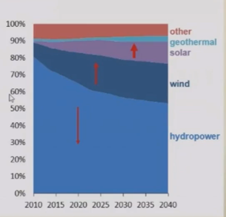
TREND OF WORLD ELECTRICITY GENERATION
FROM RENEWABLES
World net electricity generation from renewable power
(1012 kWh)
Percent share Of renewable energy
Source: International Energy Agency

Slide 4
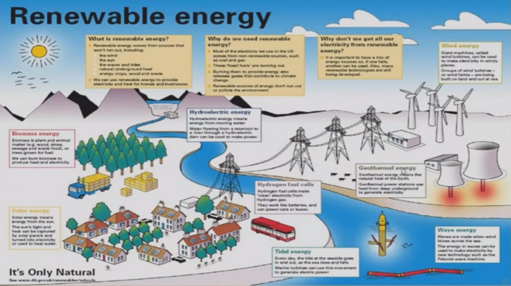
Source: https://www.mrgscience.com/ess-topic-71-energy-source-and. security.html

Slide 5
CLEAN ENERGY WORLD
Present Generation facing a lot of issues relating to water
scarcity, shortage of energy, less availability of food and land , global fuel crisis, etc.
The answer to all above lies in changing the way of utilizing resources in an efficient manner. This will include:
Using clean fuel for mobility (electricity, biOfuel, etc.)
producing power without having negative environmental impacts
Reducing dependence on fossil fuels.

Slide 6
CLEAN MOBILITY
Clean mobility refers to development of zero emission vehicle technology for movement of humans and goods
According to European Commission, transport sector alone has a share of about 29% of the total C02 emissions; However, road transport accounts for more than 70% of the emissionsn
This can be achieved by using the following :
Electric Vehicles (EV)
Hydrogen based vehicle
Hybrid Vehicle
Vehicle using bio fuels
Improving IC engine technology

